Slide 1

CROSS LAYER DESIGN
Presented by :
Name: Arashdeep Singh
Entry No : 22MMCO02
Department: School of Electronics and communication Engineering

Slide 2
agenda
INTRODUCTION 3
OSI STACK LAYER 4
LIMITATIONS 5
CROSS LAYER DESIGN 6
DRAWBACK 9

Slide 3
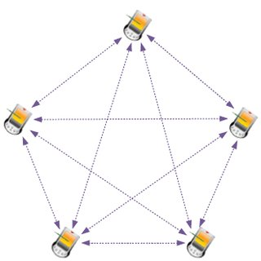
Introduction
Cross-layer design is quite an attractive approach especially for wireless multimedia networks because there's a compelling need to explore a larger optimization space in wireless networks by using multiple layers to make the best use of the limited available resources, unlike wireline networks which has abundant resources.

Slide 4
OSI Stack Layer
Host
Layer
Data
Application Layer
Data
Presentation Layer
Data
Session Layer
Segment
Transport Layer
Media
Layer
Packets
Network Layer
Frames
Data Link Layer
Bits
Physical Layer

Slide 5
LIMITATIONS IN OSI
Limited the performance of the overall architecture, due to the lack of coordination among layers.
Physical limitations.
Time-Varying behaviour.
Limited Bandwidth.
Propagation Environment.

Slide 6
Cross Layer Design
To overcome the OSI limitations cross layer design is used.
Two Types of cross layer design:-
Weak cross layer.
Strong cross layer.

Slide 7
Weak Cross Layer
Enables interaction among entities at different layer of the protocol stack.
Cross-Layer Agent
Interaction
Application Layer
Cross
Layer
Data
Module
Transport Layer
Network
Sub-interface
Mac
Sub-interface
Physical
Sub-interface
Network layer
Datalink Layer
Physical Layer

Slide 8
Strong Cross-Layer
Enables joints design of the algorithms implemented within any entity at any level of the protocol stack.
S
E
CUR
I
T
Y
QOS
MOB
I
L
I
T
Y
Application Layer
Transport Layer
Network layer
Datalink Layer
Physical Layer

Slide 9
Drawback
Increase in cost
Complexity increases.

Slide 10





thank you
Arashdeep Singh (22mmc002)
ad.sng420@gmail.com
github.com/Arashdeepsng
@ad_sng

